Slide 1
Predicting Project Success
Part 1: Intro to Project Management
CS109B Final Project April 2020
Yael Grushka-Cockayne
Twitter: @grushkay
email: ygc@hbs.edu

Slide 2

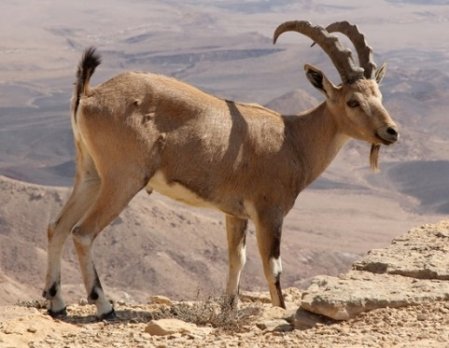
Yael Grushka-Cockayne
Teaching
  Technology and Operation Management
  Decision Analysis
  Data Science for Business
  Applied Business Analytics
  Project Management
Research
  Forecasting
  Combining expert opinion
  Individual Decision Making: Normative and Behavioral
  R&D, Innovation and New Product Development
  Project Management
BSc in Industrial Engineering and Management, MSc in Operational Research, MRes in Decision Sciences, PhD in Management Science and Operations.

Slide 3
What is a Project?
Notes:
Everyone write in the chat a project that comes to mind.

Slide 4
What is a Project?
“A project is a temporary endeavour undertaken to create a unique product or service.” (Project Management Institute)
“A unique process, consisting of a set of coordinated activities, with a specific start and finish, pursuing a specific goal with constraints on time, cost and resources.” (ISO 8402)
Notes:
Everyone write in the chat a project that comes to mind.

Slide 5
Project Characteristics
  Unique process/product/service: not routine operations
  Specific start and finish, temporary endeavour: temporary organisation
  Co-ordinated activities: complex, large, multi-disciplinary
  Specific goal: product, service, event
  Constraints: time, cost, resources
Notes:
Project Management: The planning, coordinating, scheduling and controlling of activities to meet project objectives

Slide 6
Project Objectives
  Scope (deliverable, product/service, quality, customer satisfaction)
  Time (deadline)
  Cost (budget, resources)
Scope
Time
Cost

Slide 7
Objectives – The Trinity
 | Scope | Time | Budget
Constrained
Optimize
Compromise

Slide 8
Project Planning and Management
Definition
Goal
Organization
Planning
Detailed Scope
Execution
Scope
Time
Budget
Dependencies
Schedule
Resources
Trade-Offs
Risk Analysis
Status Reporting
Corrections
Close Project
Postmortem

Slide 9
Project Definition
 | Scope | Time | Budget
Constrained |  | X
Optimize | X
Compromise |  |  | X
Definition
Goal
Organization
Scope
Time
Budget
Scope
Time
Cost

Slide 10
Project Planning and Management
Definition
Goal
Organization
Planning
Detailed Scope
Execution
Scope
Time
Budget
Dependencies
Schedule
Resources
Trade-Offs
Risk Analysis
Status Reporting
Corrections
Close Project
Postmortem

Slide 11
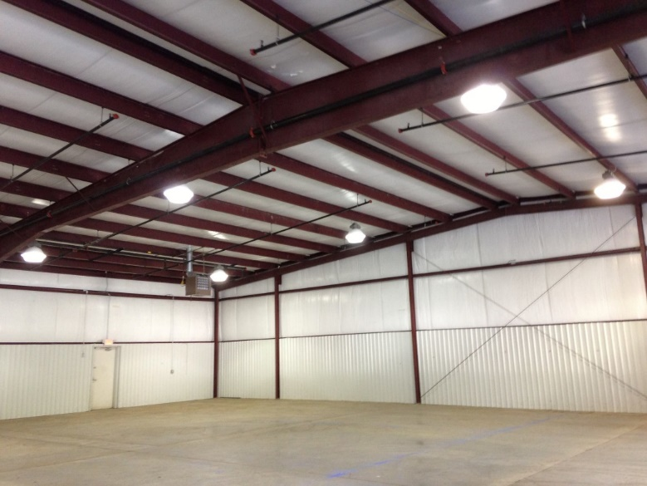

Work Breakdown Structure: Example

Slide 12
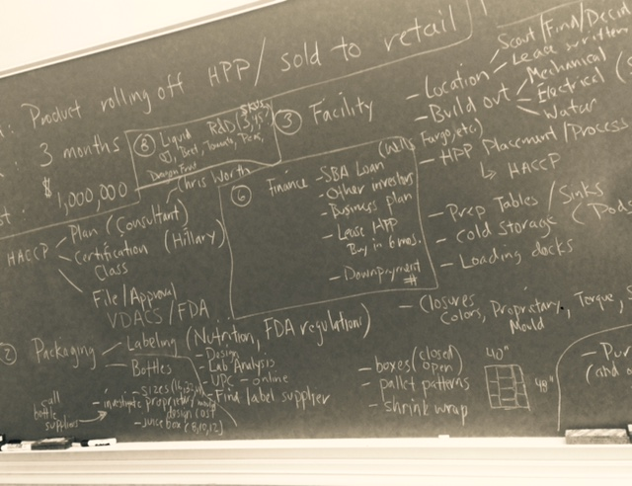
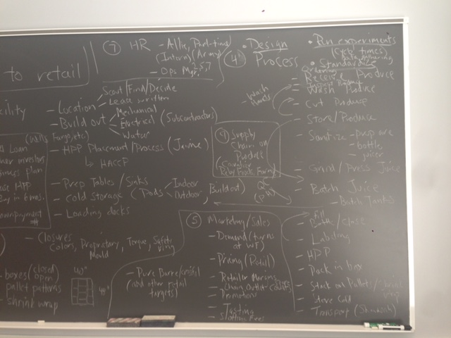
Work Breakdown Structure: Example

Slide 13
Work Breakdown Structure: Example

Slide 15
Work Breakdown Structure
Startup Project
Strategy
IT
Fundraising
Marketing
Sales
Finance
HR
Creative

Slide 16
Project Planning: Dependencies
Activity # | Description | Duration
1 | Kick off | 2
2 | Creative | 3
3 | Strategy | 2
4 | IT | 4
5 | Fundraising | 4
6 | Marketing | 5
7 | Sales | 2
8 | Finance | 2
9 | HR | 1
10 | Launch | 1
Planning
Detailed Scope
Dependencies
Schedule
Resources
Trade-Offs
Risk Analysis

Slide 17
Project Planning: Dependencies
Activity # | Description | Duration | Predecessors
1 | Kick off | 2
2 | Creative | 3 | 1
3 | Strategy | 2 | 1
4 | IT | 4 | 1
5 | Fundraising | 4 | 2
6 | Marketing | 5 | 2,3
7 | Sales | 2 | 4,6
8 | Finance | 2 | 5
9 | HR | 1 | 5,7
10 | Launch | 1 | 8,9
Planning
Detailed Scope
Dependencies
Schedule
Resources
Trade-Offs
Risk Analysis

Slide 19
Project Planning: Schedule
Creative 3 wks
Fundraising
4 wks
Finance
2 wks
Kickoff
2 wks
Strategy 2 wks
Marketing5 wks
HR
1 wks
Launch
1 wks
IT
4 wks
Sales
2 wks
Network Diagram

Slide 20
Project Planning: Critical Path Method
Phase 1: proceed left to right identifying the earliest start (ES) and earliest finish (EF) for each task
Phase 2: proceed right to left identifying the latest start (LS) and latest finish (LF) for each task
Creative 3 wks
Fundraising
4 wks
Finance
2 wks
Kickoff
2 wks
Strategy 2 wks
Marketing5 wks
HR
1 wks
Launch
1 wks
IT
4 wks
Sales
2 wks
ES EF
Task name
(duration)
LS LF
Network Diagram

Slide 21
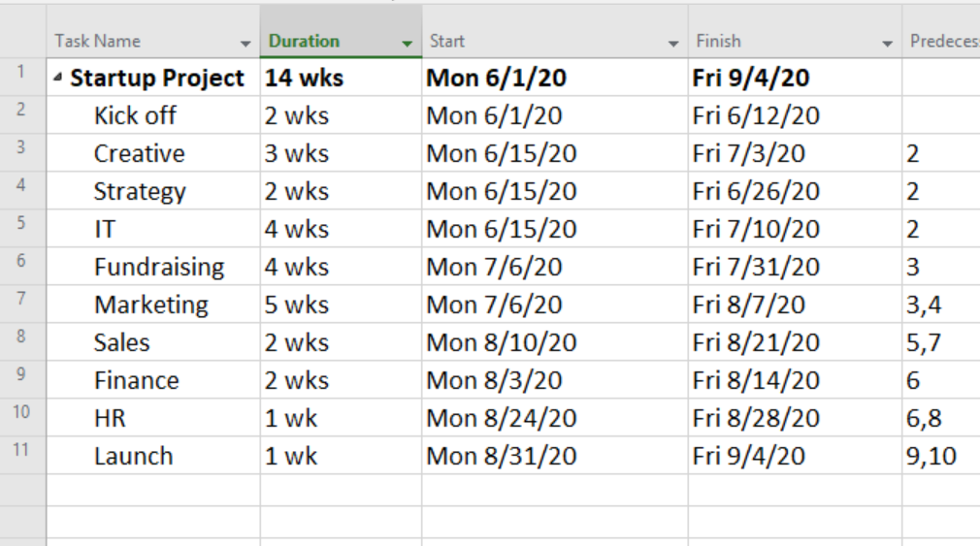
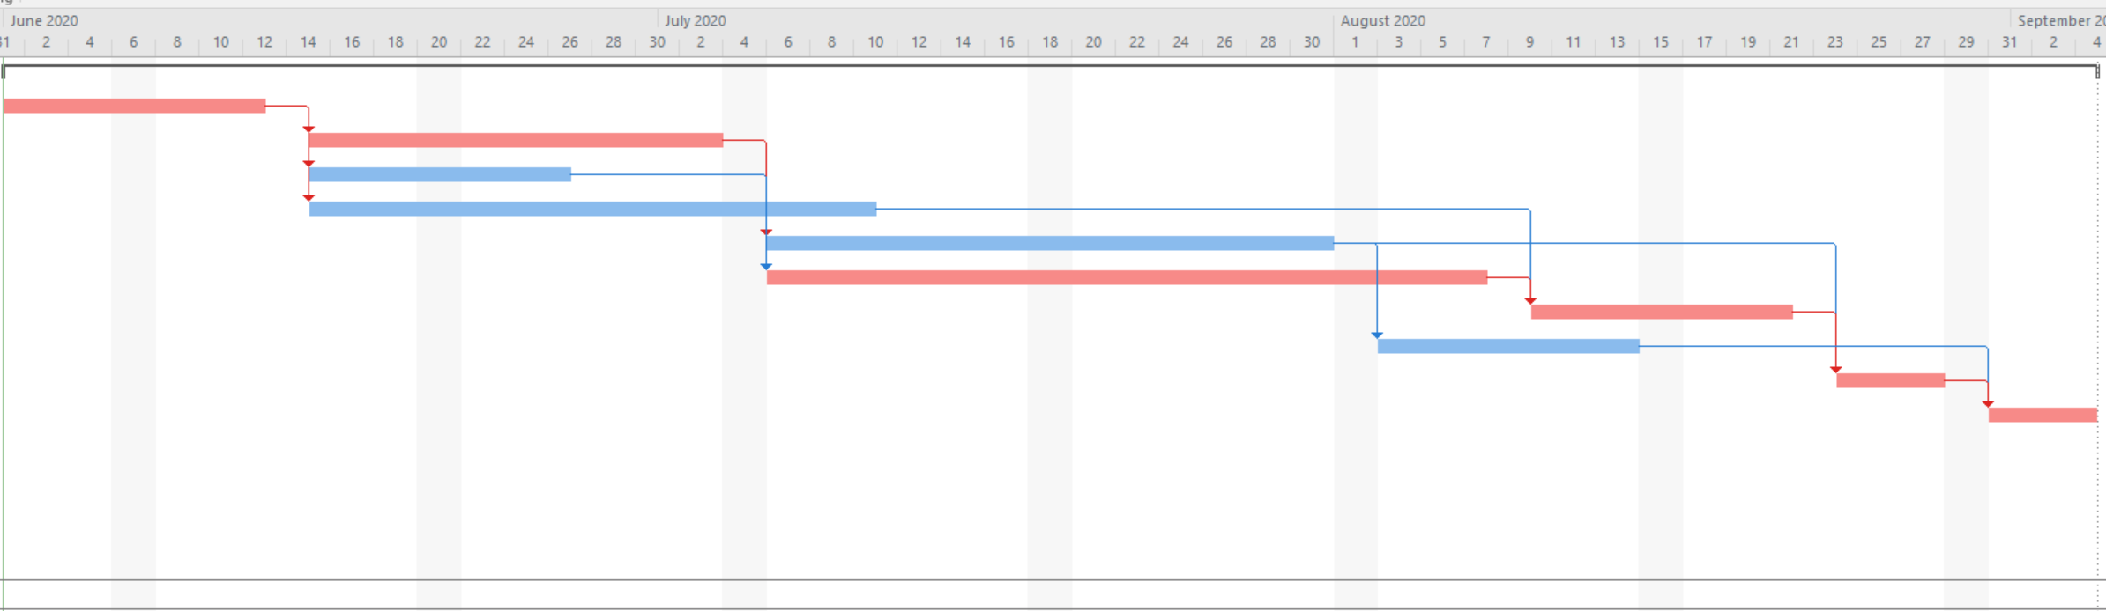
Project Schedule
Gantt chart: dependencies, milestones, progress lines
Planning
Detailed Scope
Dependencies
Schedule
Resources
Trade-Offs
Risk Analysis

Slide 22
Risk Assessment
Almost Certain
(>75%)
H
H
E
E
E
Likelihood of Occurrence
Likely
(50-75%)
M
H
H
E
E
Moderate
(25-50%)
L
M
H
E
E
Unlikely
(10-25%)
L
L
M
H
E
Rare
(<10%)
L
L
M
H
H
Unacceptable
level of risk
Insignificant
Moderate
Catastrophic
Risk X
Minor
Major
Risk Y
Risk Z
Magnitude of Impact

Slide 23
Risk Register
Priority | Risk Description | Business Consequences | Severity (0-100) | Likelihood (0-100) | Combined Score (0-100) | Risk Mitigation Plan | Owner
Notes:
For distribution in class

